Slide 1


Slide 2

Saving Lives, Improving Mothers’ Care

Slide 3
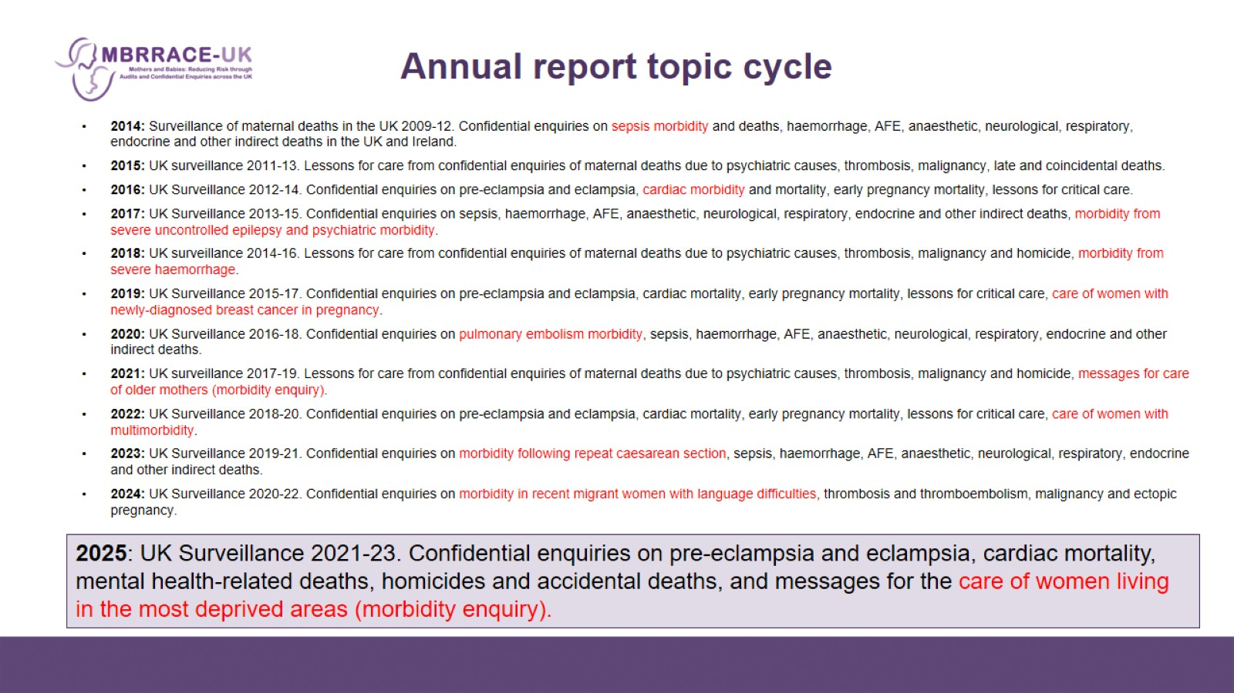
Annual report topic cycle

Slide 4

MBRRACE-UK METHODS

Slide 5
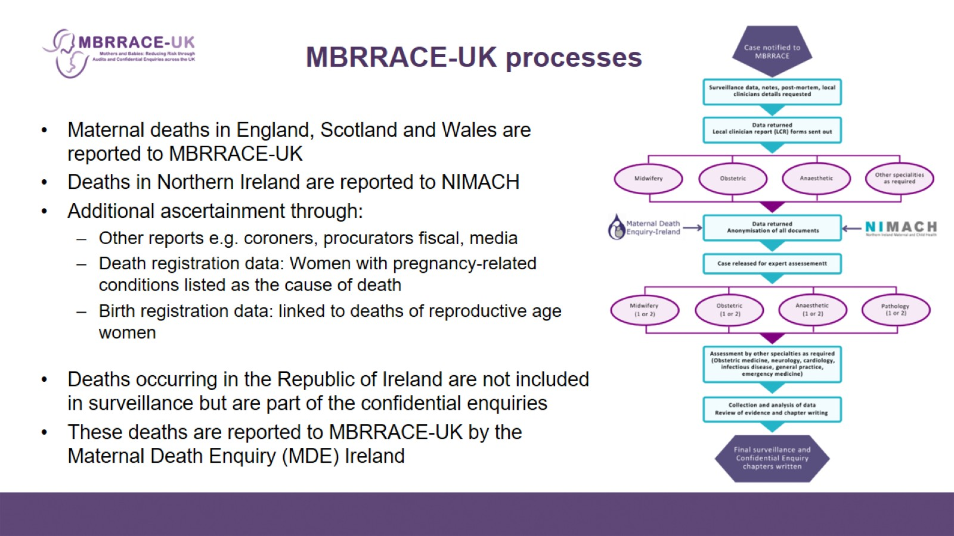
MBRRACE-UK processes

Slide 6
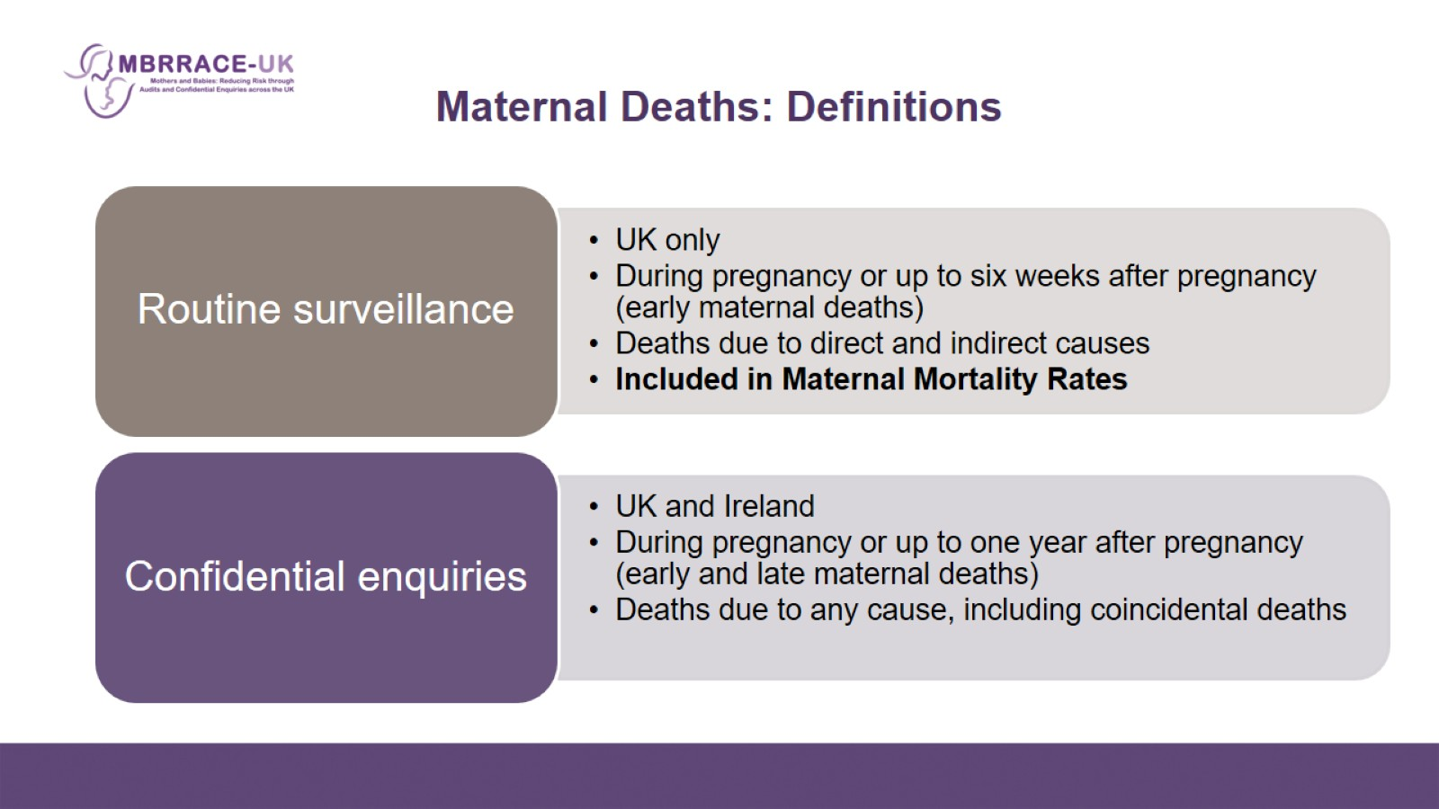
Maternal Deaths: Definitions

Slide 7

MATERNAL MORTALITY RATES

Slide 8
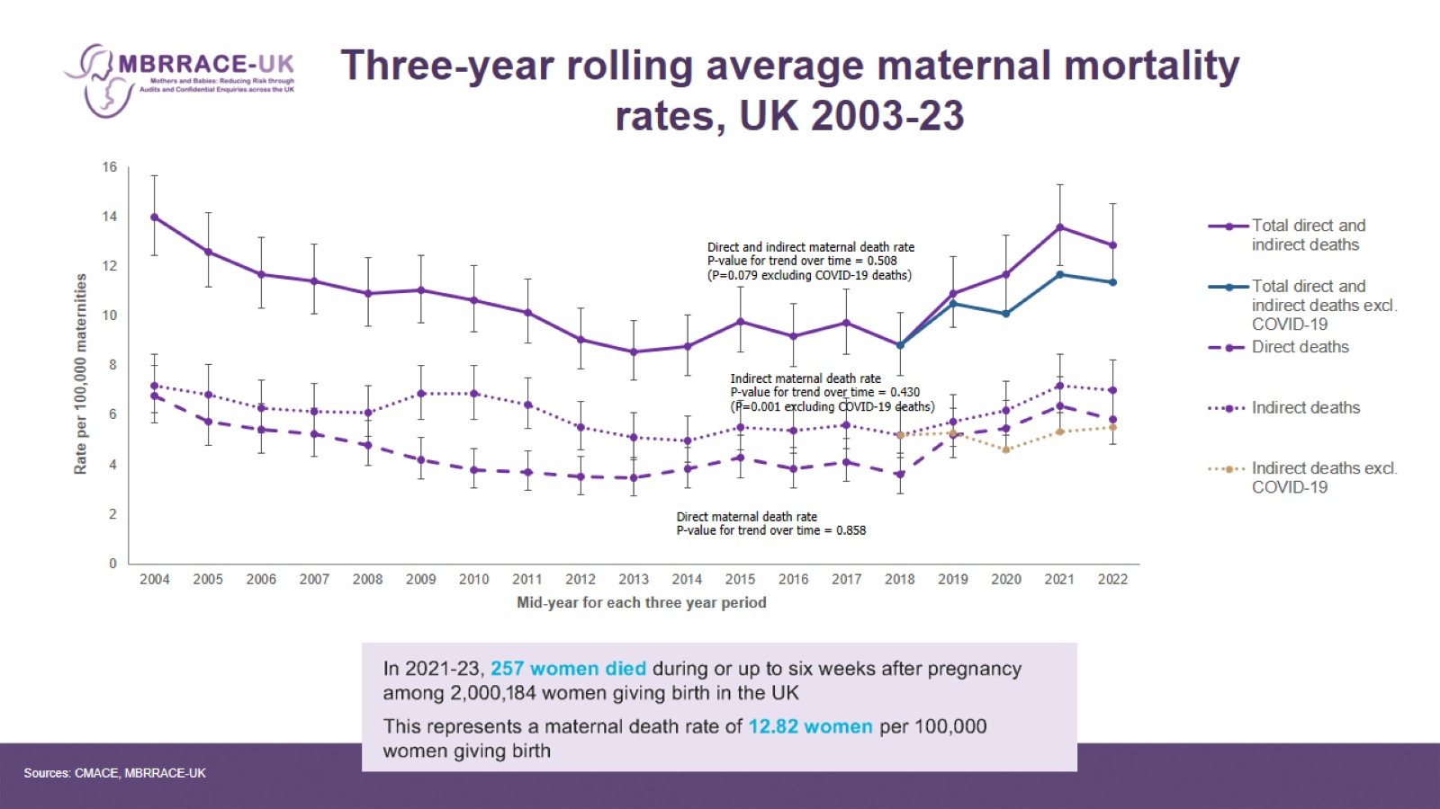
Three-year rolling average maternal mortality rates, UK 2003-23

Slide 9
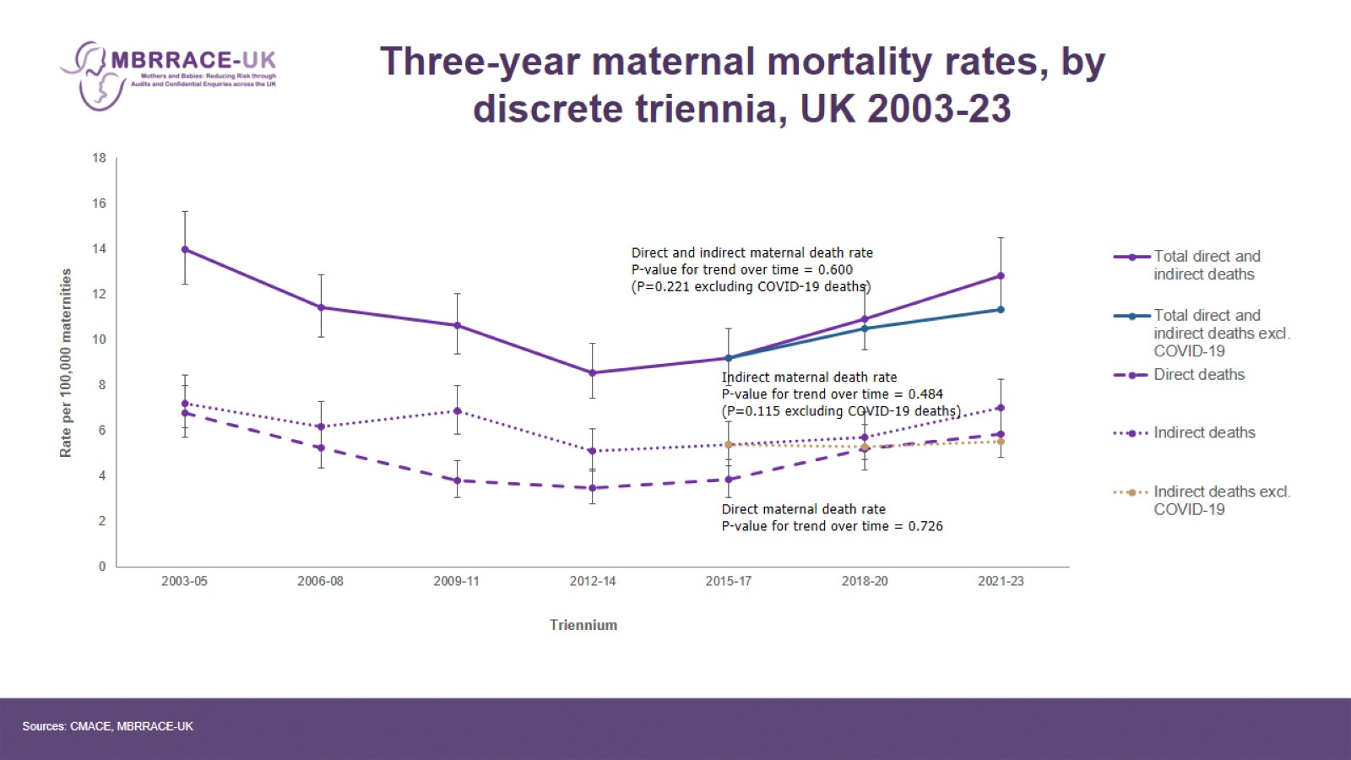
Three-year maternal mortality rates, by discrete triennia, UK 2003-23

Slide 10
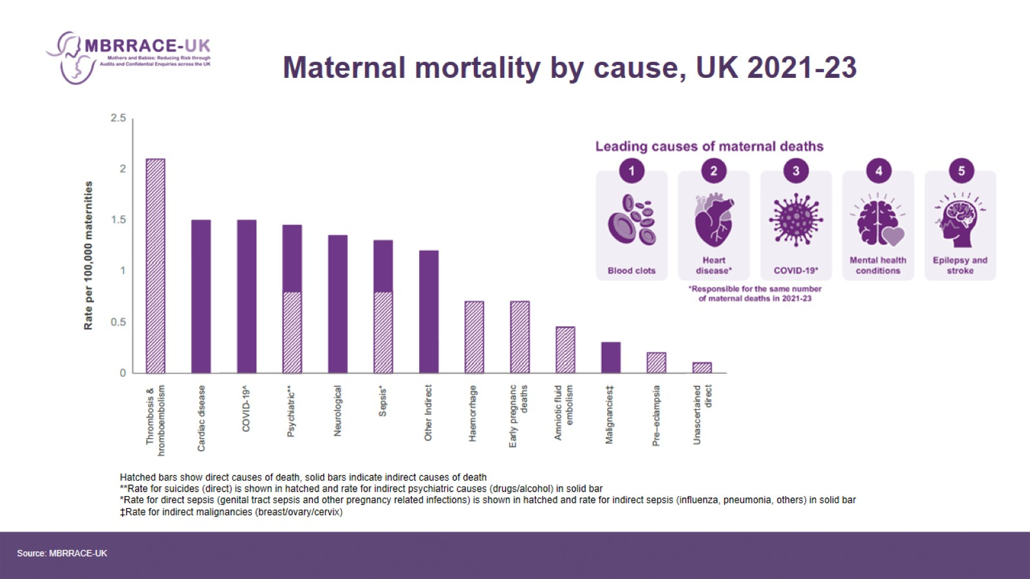
Maternal mortality by cause, UK 2021-23

Slide 11
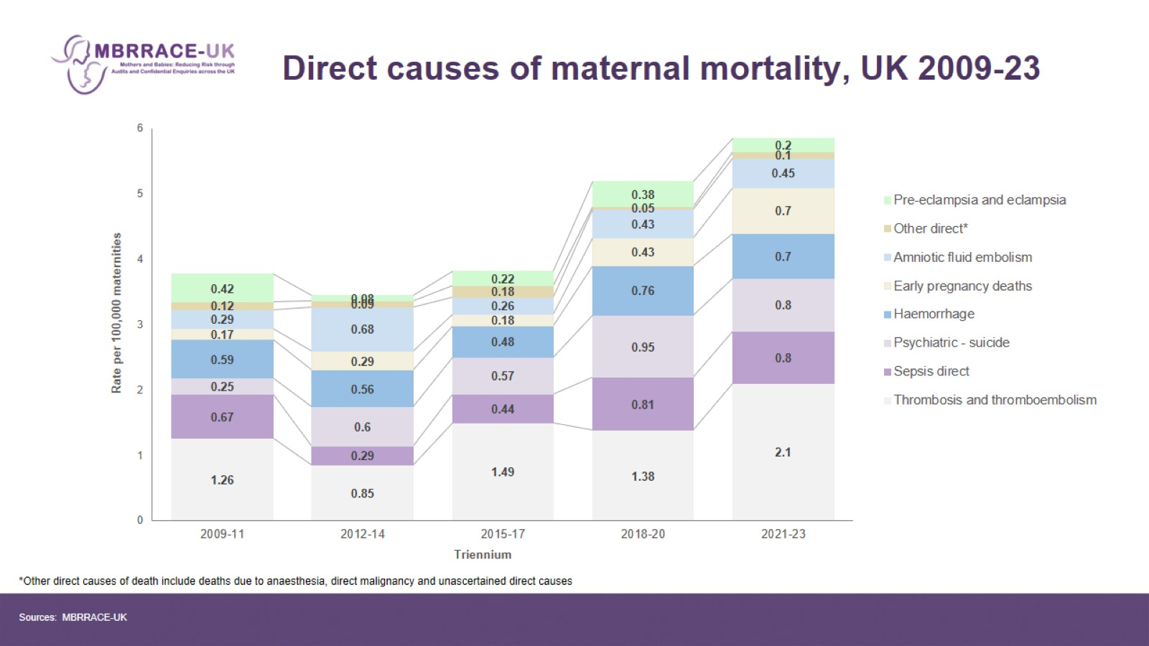
Direct causes of maternal mortality, UK 2009-23

Slide 12
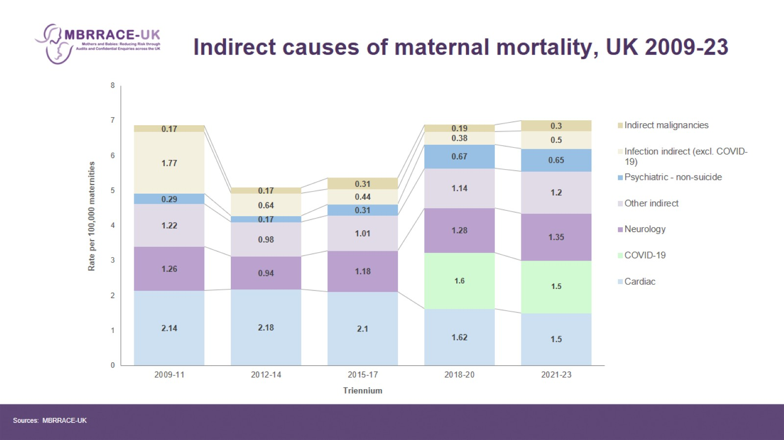
Indirect causes of maternal mortality, UK 2009-23

Slide 13
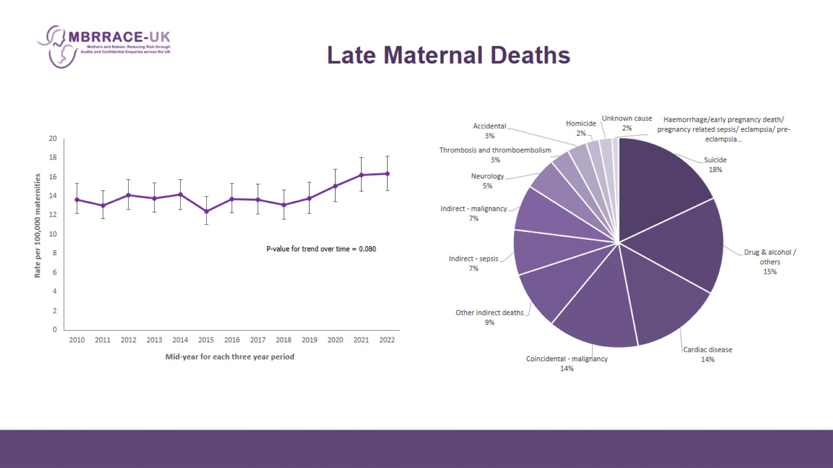
Late Maternal Deaths

Slide 14

INEQUALITIES IN MATERNAL MORTALITY

Slide 15
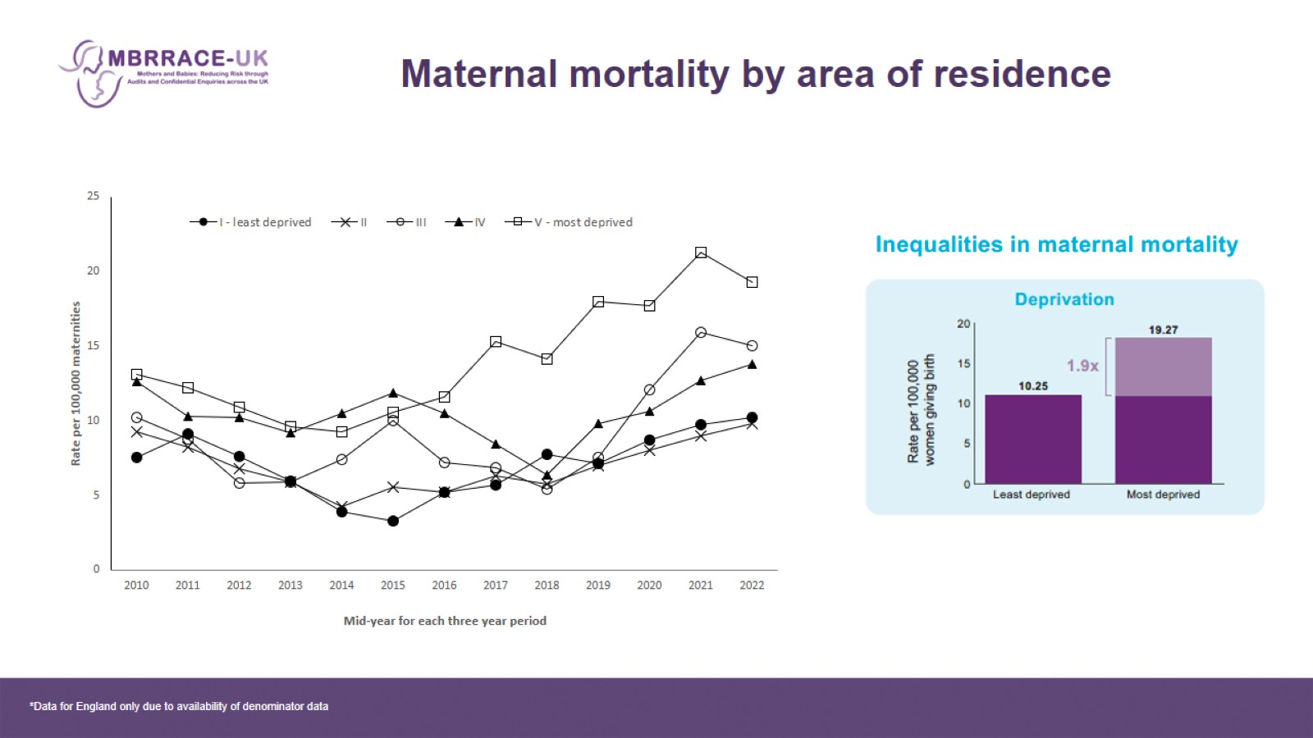
Maternal mortality by area of residence

Slide 16
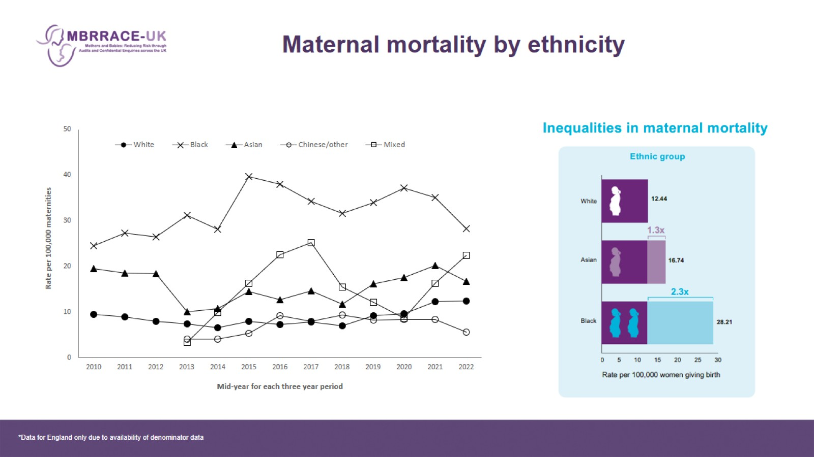
Maternal mortality by ethnicity

Slide 17
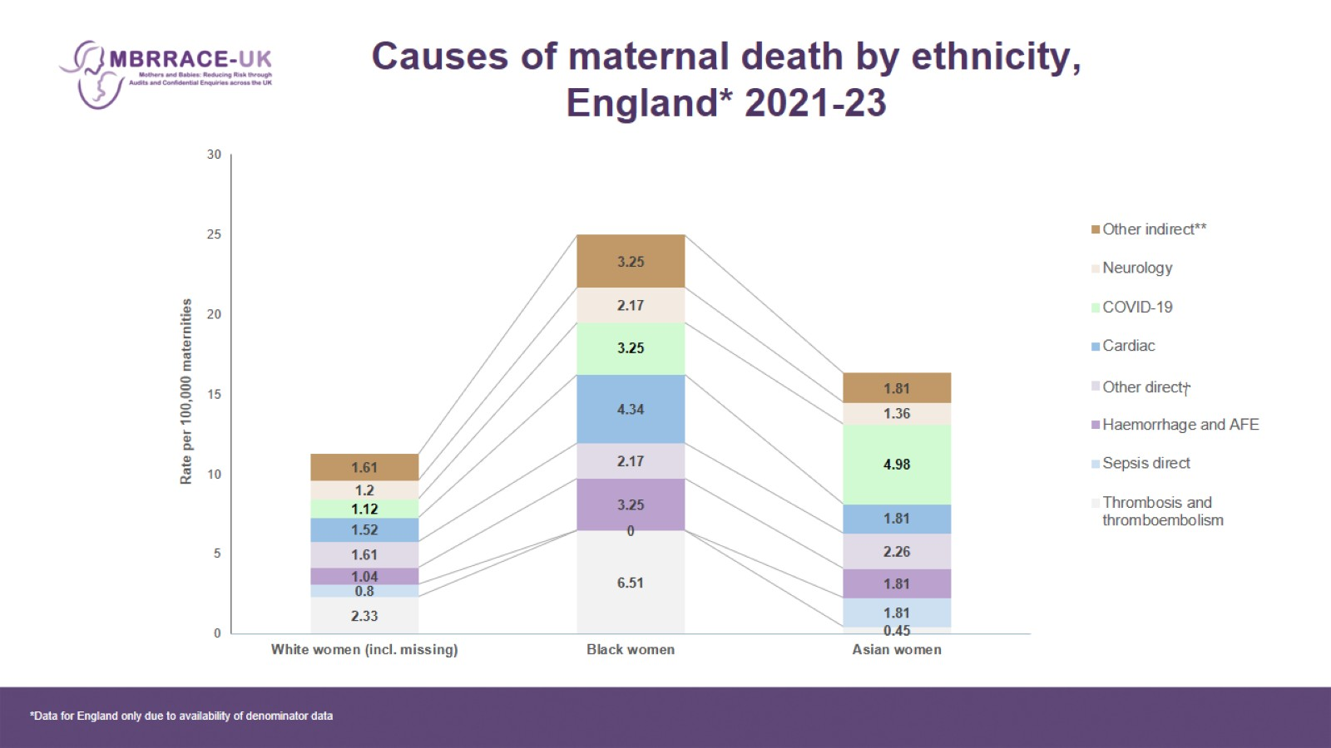
Causes of maternal death by ethnicity, England* 2021-23

Slide 18
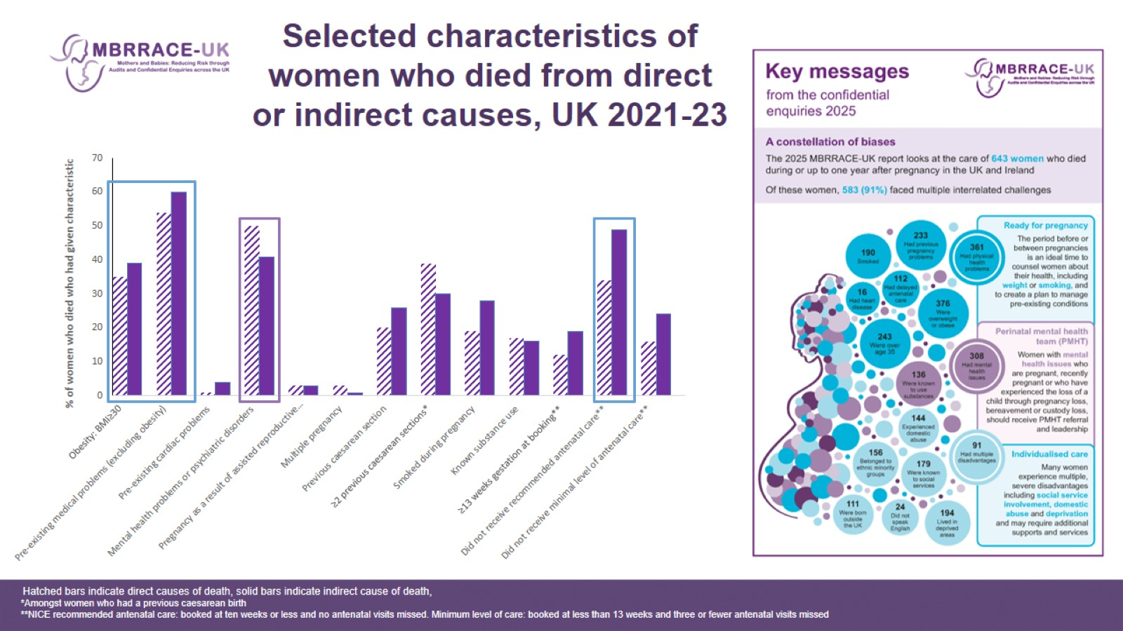
Selected characteristics of women who died from direct or indirect causes, UK 2021-23

Slide 19

CLASSIFICATION OF CARE

Slide 20
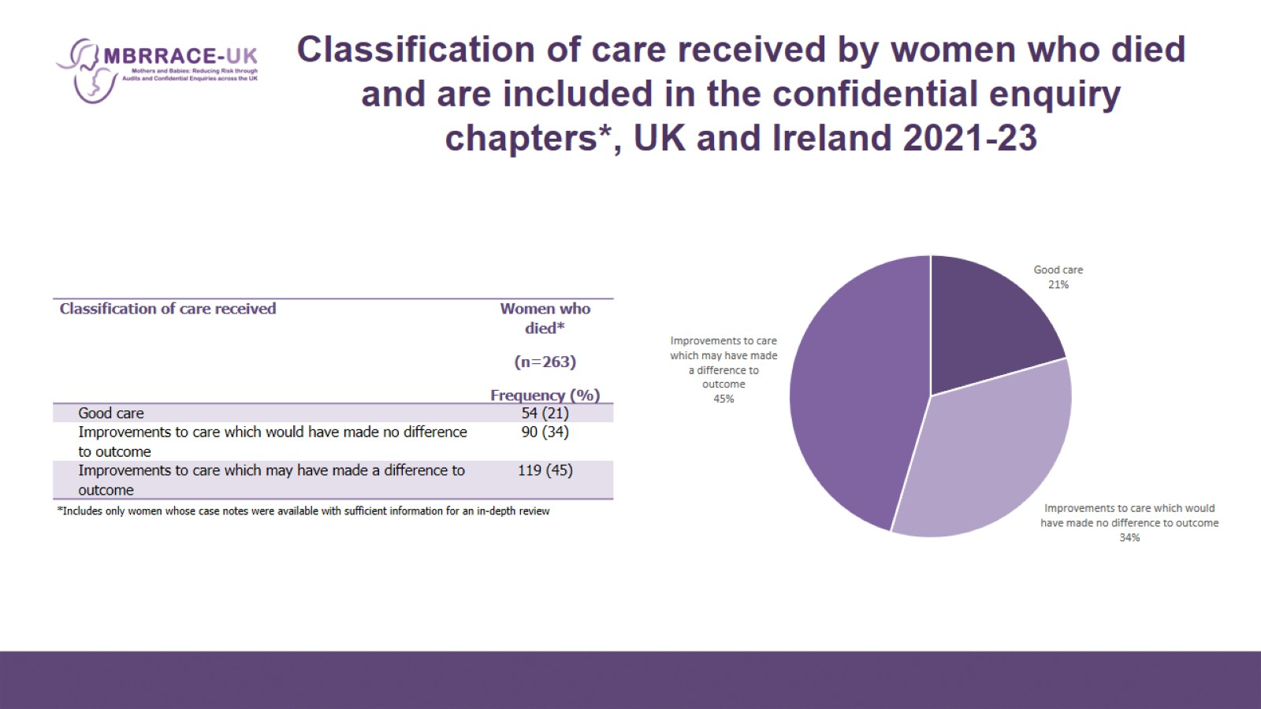
Classification of care received by women who died and are included in the confidential enquiry chapters*, UK and Ireland 2021-23

Slide 21
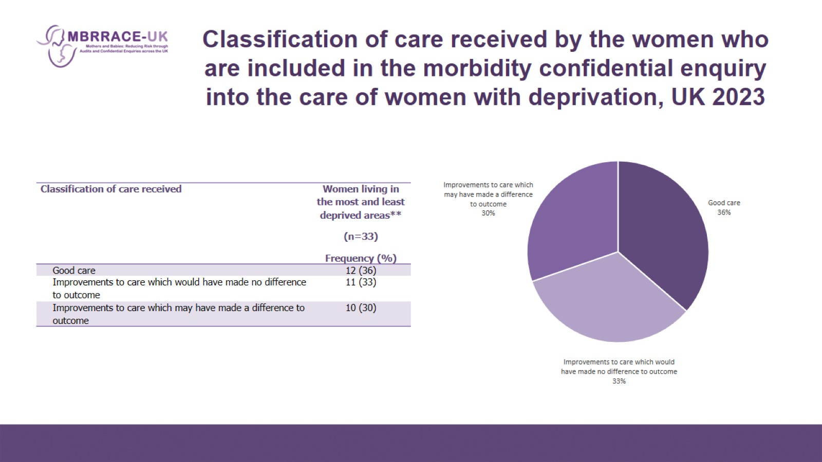
Classification of care received by the women who are included in the morbidity confidential enquiry into the care of women with deprivation, UK 2023

Slide 22
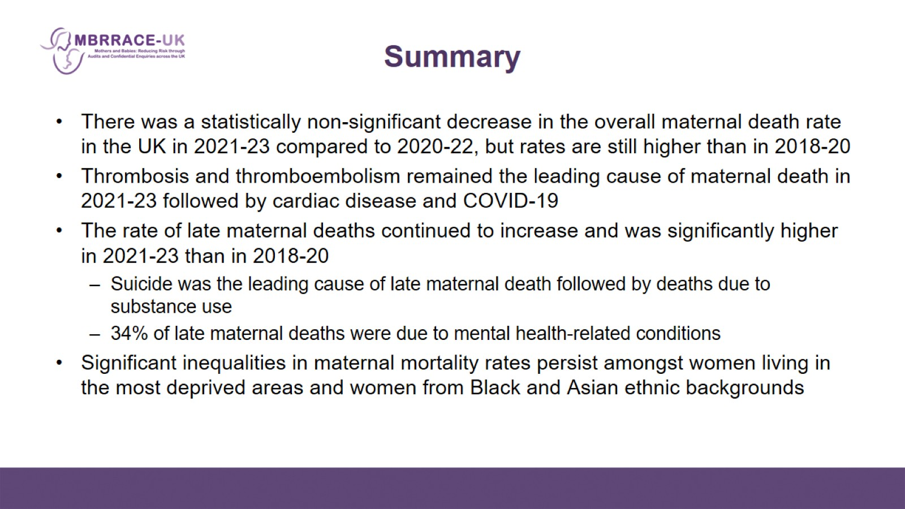
Summary

Slide 23

Acknowledgements

